Slide 1
Sugon HPC: Workstation
Moscow, 12/2015

Slide 2
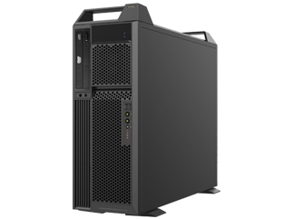
Workstation Family
Professional Graphic Cloud Workstation
Management & High Securtiy
W760-G20
Dual-Processor Workstation
Top performance and extreme extention
W560-G20
High Performance/Price
Entry Level Workstation
Starters of Graphic procedure
W320-G10
Notes:
对CPU追求很高
与服务器不一样

Slide 3
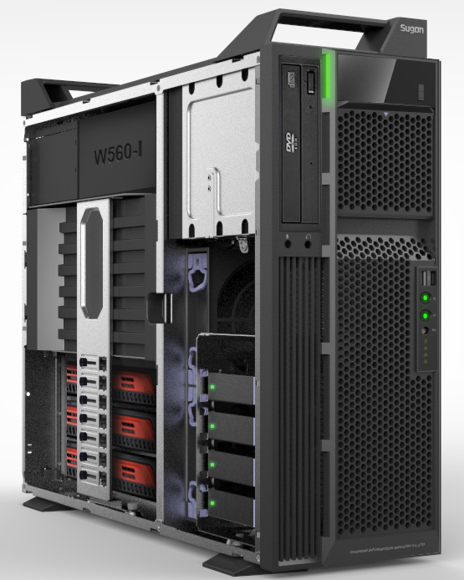
W560-G20
Performance | New Intel E5-2600V3, DDR4 Memory, Nvidia Maxwell Graphic Card Up to 3 Graphic cards/GPU
Price | Special workstation motherboard, onboard audio No onboard graphic card, No onboard SAS controller No onboard BMC
Low Noise | 42dB on full workload
High Quality | Mold proportion reached 95% Effect light enhancement Add extension card holder

Slide 4
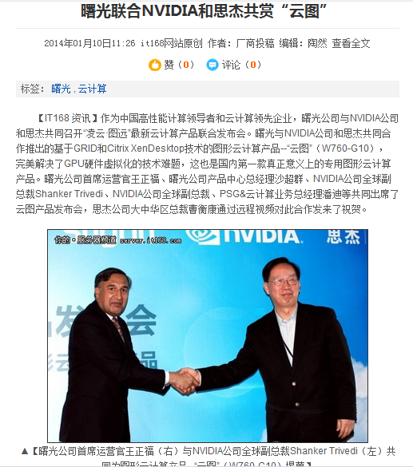
Next Generation Workstation – W760-G20
OS
Windows
Server
2008
Windows7
Windows7
Windows7
Atalas
XMM
Xen Server
Hardware
4*1536 CUDA core
2TB Storage（8*SAS，RAID10）
128G Memory
3.0GHz Processor 20 cores/40 Threads

Slide 5
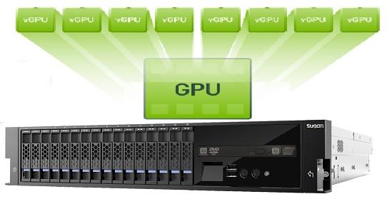
vGPU Solutions
Virtual Machine

Slide 6
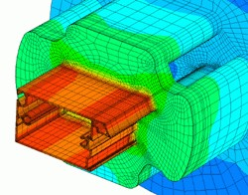
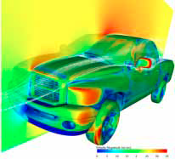
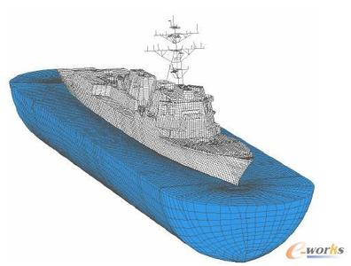
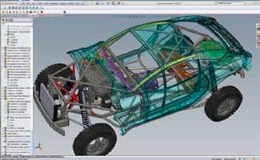
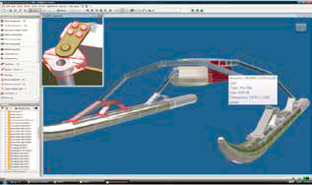
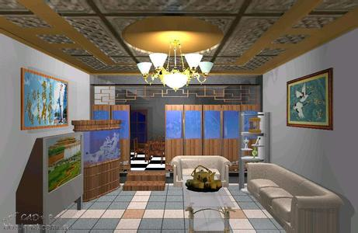
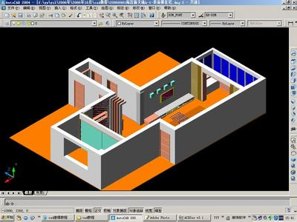
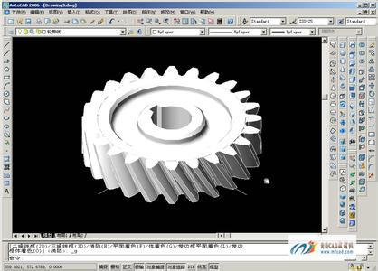
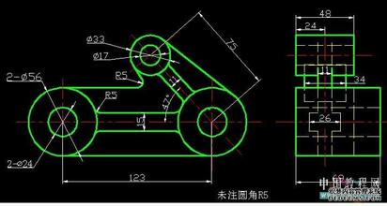
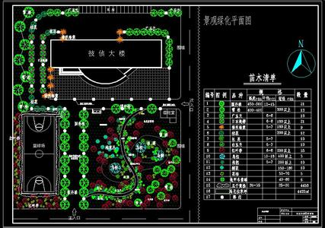
How to select the model of workstation?
Fluid analysis
Simulation
Meteorological analysis
CAE，Finite element
GIS
Maya
Siemens NX
Catia
3D Max
Dassault
ProE
Inventor
Solidworks AUTOCAD
Photoshop
Cadence
Maximus
K6000
K5000
K4000
K2000
K600
K420/NVS315
W560-G10
2-Way E5
Automobile, aircraft, ship
Analysis, 3D render
W560-G10
1-Way E5
Mechanical design
3D animation
Tools, Parts design
W320-G10
Production layout
Graphic design
Circuit design

Slide 7
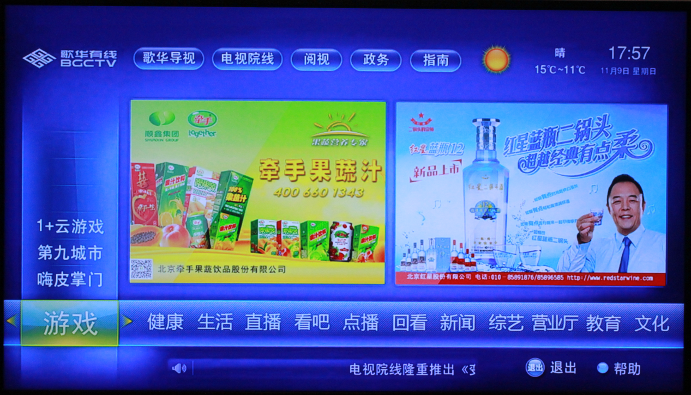
Application: OTT Transcoding & Online Games
Application 1:
Transcoding OTT and broadcast video services, the need to use video transcoding H.264 compression, storage / transmission.
2 * E5-2697 able to handle: 4* 1080P video (30)
1* Atlas with 2*E5-2650 and 2 * K1 can handle: 64*1080P video
Application 2:
Online games: CPU and GPU general reached 1: 1 relationship
Use GRID, reduce the CPU transcoding pressure
2U, 2CPU, 2GPU constitute a perfect match

